Slide 1
Arise and Leader, Youth of Ghana!

Slide 2

Why Ghana?

Slide 3
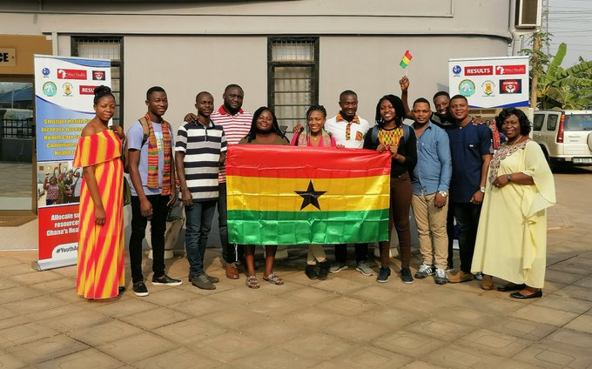
Why You?

Slide 4
Who is a leader?
A leader is someone who can see how things can be improved and rallies people toward that better vision.

Slide 5
Attributes of a Good Leader
Influence
put people first
ready to serve
empathetic and connect with people

Slide 6
Tools for building Leadership Capacity
Serve
People (Mentors, Coaches, friends)
Online Resources
Be ready to be vulnerable, die to self.

Slide 7
You want to be a leader?
Eschew pride
Be vulnerable
Be prepared to learn
Read

Slide 8
…. What to be a leader?
Do if afraid
Welcome feedback
Be ready to learn and unlearn

Slide 9
…. What to be a leader?
Leadership is a process not a destination
Be patient with yourself

Slide 10
Opportunity to Serve?
Just look around you

Slide 11

The Story of Diana

